Slide 1
Processing Event-based Cameras : Generative model Perspective
류시모

Slide 2
Various visual reconstruction tasks, using generative models
Denoising
Enhancing
Interpolation (Frame synthesis)
Recognition in darkness
…

Slide 3
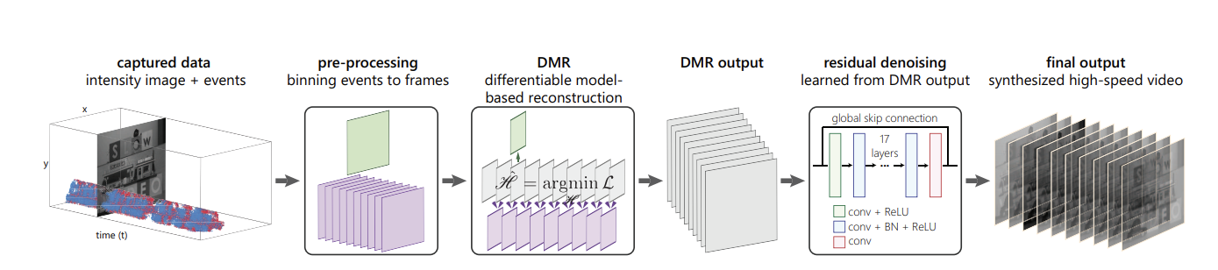
TVFS
Event → Image

Slide 4
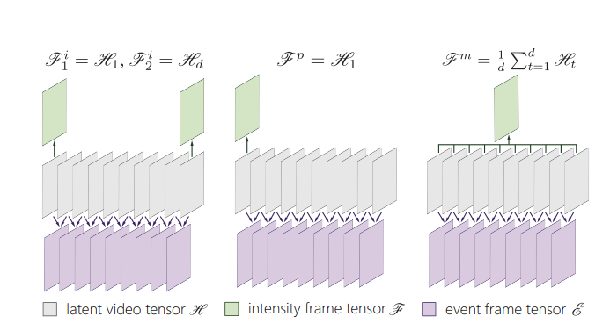
TVFS

Slide 5
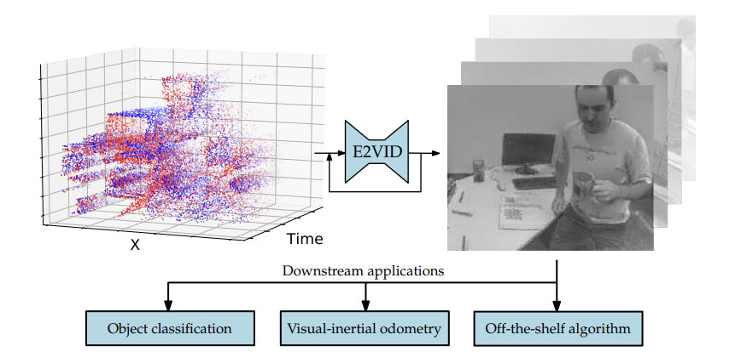
Event based Camera – Frame Synthesis (only from events)
Events-to-video: Bringing modern computer vision to event cameras

Slide 6
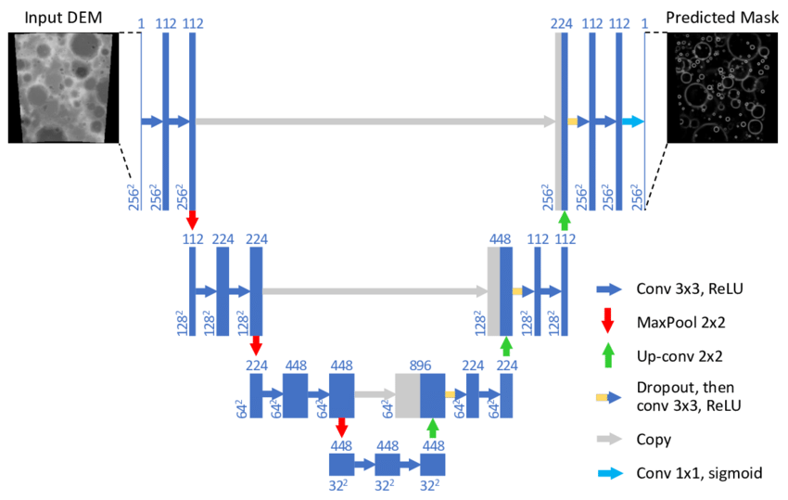
Structure : Unet

Slide 7
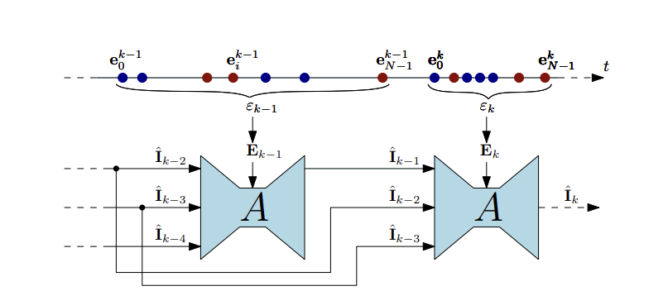
Processing Datatype :

Slide 8
Implementation ?
https://github.com/uzh-rpg/rpg_e2vid

Slide 9
Ideas
+ NeRF
+ intensity Guided RF?
SeTR style Transformer generation?

